Slide 1
General Computer Knowledge
COE 201- Computer Proficiency

Slide 2
Outline
Hardware Vs. Software
Binary Representation
Computer Components
CPU
Data Storage
Input/Output Devices
BIOS
Operating System

Slide 3
Hardware
The part of the computer that you can see and touch.
Example: CD-ROM, monitor, printer, keyboard
Devices that are required to store and execute (or run) the software.
Serve as the delivery system for software solutions.

Slide 4
Software
Also known as program or application.
Collection of instructions that enables a user to interact with the computer.
Enables a computer to perform a specific task
Example: Microsoft Word, Excel, OS, Firefox
To deliver a set of instructions, software is installed on hardware.

Slide 5
Binary Representation
All digital electronic devices rely on binary characters: 0’s and 1’s.
The computer converts all characters and numbers into a string of 0’s and 1’s.

Slide 6
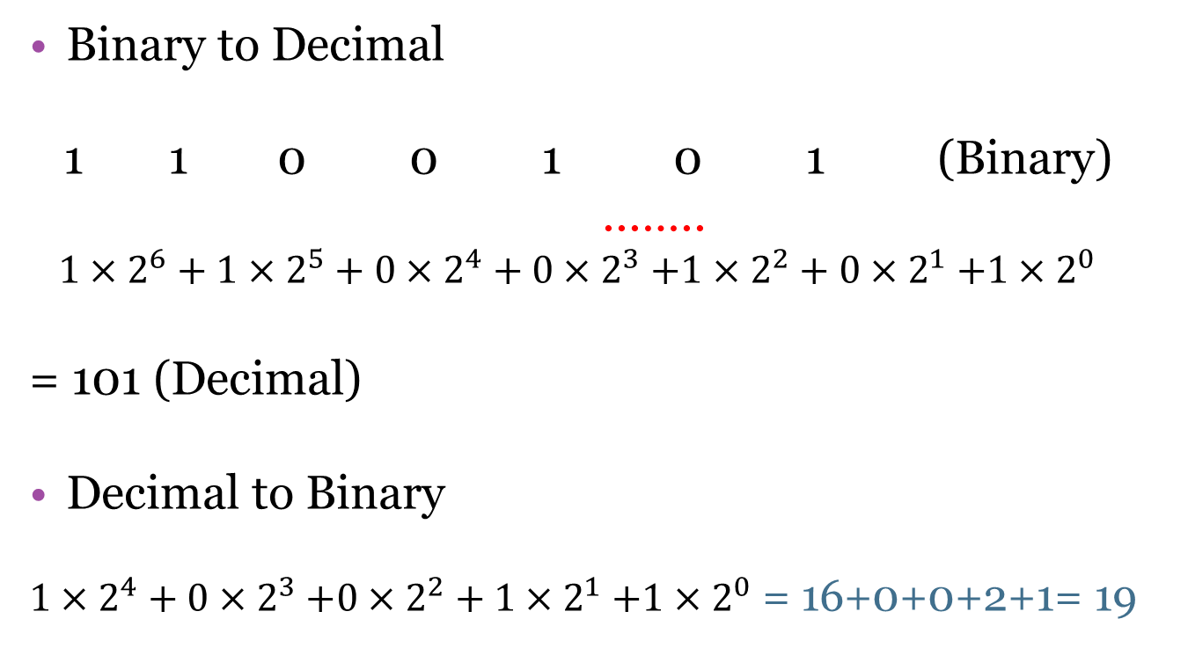
Conversion Between Binary and Decimal
Binary to Decimal
1 1 0 0 1 0 1 (Binary)
...…..
$1×2^{6}+1×2^{5}+{0×2}^{4}+0{×2}^{3}+1×2^{2}+0{×2}^{1}+1{×2}^{0}$
= 101 (Decimal)
Decimal to Binary
${1×2}^{4}+0{×2}^{3}+0×2^{2}+1{×2}^{1}+1{×2}^{0}$ = 16+0+0+2+1= 19
$$19\left(decimal\right)=10011 (Binary)$$

Slide 7
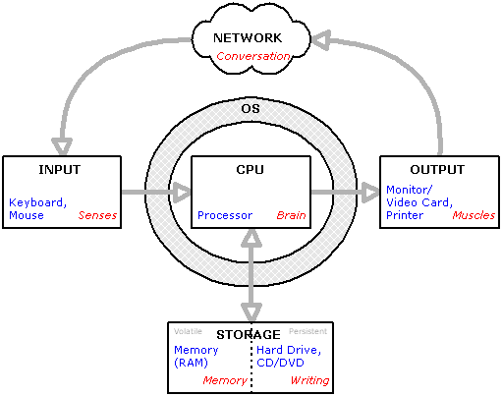
Computer Components

Slide 8
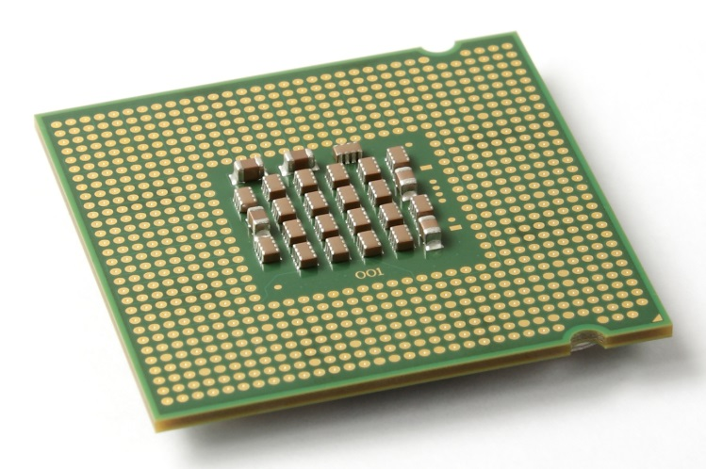
CPU
Also known as Central Processing Unit.
Is a hardware that carries out the instructions of a computer program.
Composed of:
Control Unit
Arithmetic Logic Unit (ALU)

Slide 9
CPU
Arithmetic Logic Unit (ALU)
Performs arithmetic and logical operations
Control Unit (CU)
Extracts instructions from memory and decodes and executes them, calling the ALU when necessary.

Slide 10
CPU
Clock Speed:
Amount of time to execute a set of instructions.
Hz(Hertz)
1 Hz = one cycle per second.
KHz(Kilo Hertz)
1 KHz = one thousand cycles per second.
MHz(Mega Hertz)
1 MHz = one million cycles per second.
GHz (Giga Hertz)
1 GHz = one billion cycles per second.

Slide 11
Data Storage
Two types of data storage:
Primary Storage Devices
CPU registers
Memory cache
Main memory
Secondary Storage Devices
Hard Disks
CD’s
DVD’s
Capacity
Access Time
Access Time
Capacity

Slide 12
RAM
Random Access Memory.
Is a processing memory
Stores data or program while they are being used.
When the program or file is closed, the data is removed from RAM.
Has no moving part therefore it is fast to store and take data from.
Exists as a chip on the motherboard near the CPU.
Requires power.

Slide 13
Secondary Storage Devices
Auxiliary storage devices
used to store instructions and data when they are not being used in memory.
Common types are:
Hard Disks
Consists of one or more rigid metal platters coated with a metal oxide material that allows data to be recorded magnetically on the surface of the platters.
CDs
DVDs

Slide 14
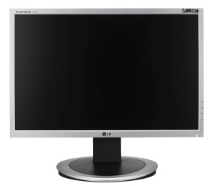
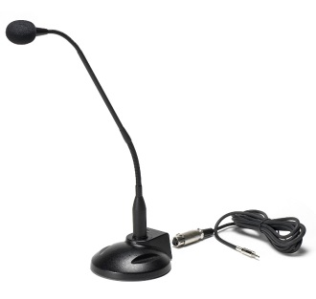
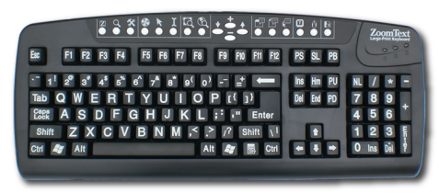
Input/output Devices
Input devices are what we use to tell the computer what to do.
Example: Keyboard, mouse, microphone
Output devices are what makes you hear or see what the computer is doing.
Example: Monitor, speaker, printer

Slide 15
BIOS
Basic Input Output System.
First software run by a PC when powered on.
Fundamental purposes of the BIOS:
Initialize and test the system hardware components.
Load the operating system.
Stored on a non-volatile ROM chip on the motherboard

Slide 16
BIOS
Has a menu based user interface (UI) accessed by pressing certain key when the PC starts.
In the BIOS UI, a user can:
Configure hardware.
Set the system clock.
Enable or disable system components.
Select which devices are potential boot devices.
Set various password prompts.
Some BIOS chip allows overclocking the CPU.

Slide 17
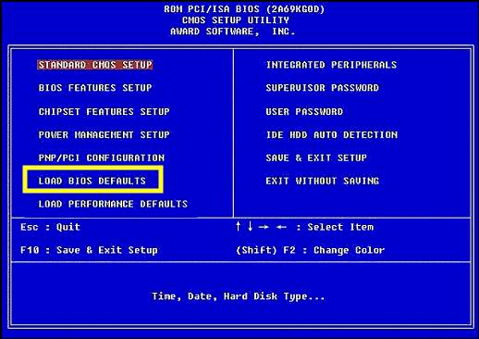
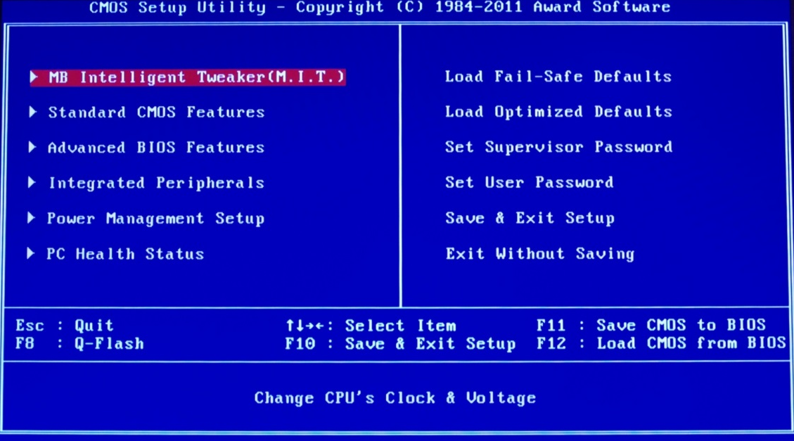
BIOS Interface

Slide 18
Operating System
Collection of software that manages computer hardware.
Divides CPU core time along different programs
Manages access to RAM, I/O and disk
Enforces system and security policy to isolate applications from each other
First program that starts when the pc is on.
Provides the user with easy-to-use interface.
Example: Windows, Linux, iOS, Android

